Slide 1
Welcome to
CS 235 Data Structures
2-3-4 Self-balancing Trees (42)
Chapter 11.5, pgs. 656-663.

Slide 2
Tip #42: How to Choose an STL Container
Performance
Logarithmic
Constant Time
Amortizable
Complex
Memory
Containable in memory
Memory usage
Data
Ordered
Sortable
Duplicates
Restrictable
Traversable

Slide 3
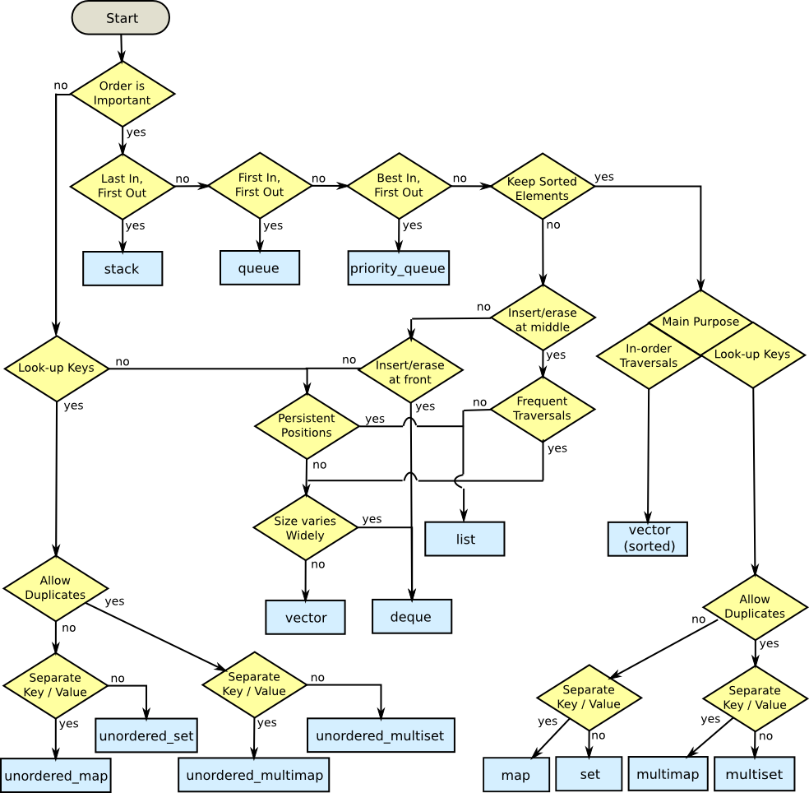
Which STL Container to Use?

Slide 4
11.5 2-3-4 and B-Trees
2-3-4 Trees
Implementation of the Two_Three_Four_Tree Class
Relating 2-3-4 Trees to Red-Black Trees
B-Trees
11.5, pgs. 663-681

Slide 5
B-Trees and 2-3-4 Trees
2-3-4 trees are a special case of the B-tree where order is fixed at 4.
The 2-3 tree was the inspiration for the more general B-tree which allows up to n children per node, where n may be a very large number.
The B-tree was designed for building indexes to very large databases stored on a hard disk.
A node in a 2-3-4 tree is called a 4-node.
A 4-node has space for three data items and four children.
Fixing the capacity of a node at three data items simplifies the insertion logic.
A search for a leaf is the same as for a 2-3 tree or B-tree.
If a 4-node is encountered, we split it.
When we reach a leaf, we are guaranteed to find room to insert an item.

Slide 6
Insertion into a 2-3-4 Tree
If a 4-node is encountered while searching, we'll split it immediately.
Fixing the capacity of a node at three data items simplifies the insertion logic.
62
14,21,38
79
4
15
28
55,56
68,71
90
When we reach a leaf, we are guaranteed to find room to insert an item.

Slide 7
Insertion into a 2-3-4 Tree
62
A number larger than 62 is inserted into one of this subtree's leaf nodes
14,21,38
79
4
15
28
55,56
68,71
90

Slide 8
Insertion into a 2-3-4 Tree
62
14,21,38
79
4
15
28
55,56
68,71
90
A number between 63 and 78, inclusive, is inserted into this 3-node making it a 4-node

Slide 9
Insertion into a 2-3-4 Tree
62
14,21,38
79
4
15
28
55,56
68,71
90
A number larger than 79 is inserted into this 2-node making it a 3-node

Slide 10
Insertion into a 2-3-4 Tree
Inserting 25
62
14,21,38
79
4
15
28
55,56
68,71
90

Slide 11
Insertion into a 2-3-4 Tree
As soon as a 4-node is encountered, split it and move the middle value into the parent
Inserting 25
62
14,21,38
79
4
15
28
55,56
68,71
90

Slide 12
Insertion into a 2-3-4 Tree
As soon as a 4-node is encountered, split it and move the middle value into the parent
Inserting 25
21,62
14
38
79
4
15
28
55,56
68,71
90

Slide 13
Insertion into a 2-3-4 Tree
Inserting 25
21,62
14
38
79
4
15
25,28
55,56
68,71
90
Then add the value (25) in a leaf node

Slide 14
Insertion into a 2-3-4 Tree
21,62
14
38
79
4
15
25,28
55,56
68,71
90
This immediate split guarantees that a parent will not be a 4-node, and we will not need to propagate a child or its parent back up the recursion chain. The recursion becomes tail recursion.

Slide 15
Insertion into a 2-3-4 Tree
21,62
14
38
79
4
15
25,28
55,56
68,71
90
25 could have been inserted into the leaf node without splitting the parent 4-node, but always splitting a 4-node when it is encountered simplifies the algorithm with minimal impact on overall performance

Slide 16
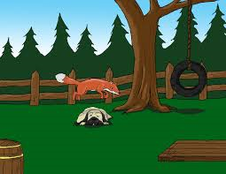
2-3-4 Tree Example
Build an 2-3-4 tree from the words:
"The quick brown fox jumps over the lazy dog."

Slide 17
2-3-4 Tree Example
“The quick brown fox jumps over the lazy dog”

Slide 18
2-3-4 Tree Example
“The quick brown fox jumps over the lazy dog”
The

Slide 19
2-3-4 Tree Example
“The quick brown fox jumps over the lazy dog”
The, quick

Slide 20
2-3-4 Tree Example
“The quick brown fox jumps over the lazy dog”
The, brown, quick

Slide 21
2-3-4 Tree Example
“The quick brown fox jumps over the lazy dog”
The, brown, quick
As soon as a 4-node is encountered, split it and move the middle value into the parent

Slide 22
2-3-4 Tree Example
“The quick brown fox jumps over the lazy dog”
brown
The
quick
As soon as a 4-node is encountered, split it and move the middle value into the parent

Slide 23
2-3-4 Tree Example
“The quick brown fox jumps over the lazy dog”
brown
The
fox, quick

Slide 24
2-3-4 Tree Example
“The quick brown fox jumps over the lazy dog”
brown
The
fox, jumps, quick

Slide 25
2-3-4 Tree Example
“The quick brown fox jumps over the lazy dog”
brown
The
fox, jumps, quick
As soon as a 4-node is encountered, split it and move the middle value into the parent

Slide 26
2-3-4 Tree Example
“The quick brown fox jumps over the lazy dog”
brown, jumps
The
fox
quick
As soon as a 4-node is encountered, split it and move the middle value into the parent

Slide 27
2-3-4 Tree Example
“The quick brown fox jumps over the lazy dog”
brown, jumps
The
fox
over, quick

Slide 28
2-3-4 Tree Example
“The quick brown fox jumps over the lazy dog”
brown, jumps
The
fox
over, quick, the

Slide 29
2-3-4 Tree Example
“The quick brown fox jumps over the lazy dog”
brown, jumps
The
fox
over, quick, the

Slide 30
2-3-4 Tree Example
“The quick brown fox jumps over the lazy dog”
brown, jumps, quick
The
fox
over
the

Slide 31
2-3-4 Tree Example
“The quick brown fox jumps over the lazy dog”
jumps
brown
quick
The
fox
over
the

Slide 32
2-3-4 Tree Example
“The quick brown fox jumps over the lazy dog”
jumps
brown
quick
The
fox
lazy, over
the

Slide 33
2-3-4 Tree Example
“The quick brown fox jumps over the lazy dog”
jumps
brown
quick
The
dog, fox
lazy, over
the

Slide 34
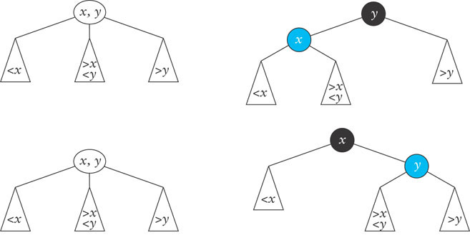
Relating 2-3-4 Trees to Red-Black Trees
A Red-Black tree is a binary-tree equivalent of a 2-3-4 tree.
A 2-node is a black node.
A 3-node can be represented as either a black node with a left red (blue) child or a black node with a right red (blue) child.
A 4-node is a black node with two red (blue) children.

Slide 35
Relating 2-3-4 Trees to Red-Black Trees
Inserting value z that is between x and y

Slide 36
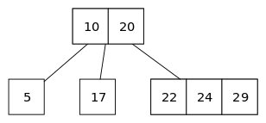
Insert 25 into this 2-3-4 tree.

Slide 37
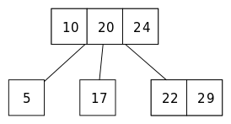
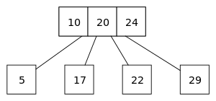
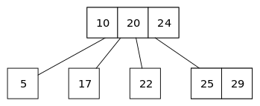
Insert 25 into this 2-3-4 tree.
Begin at the root (10, 20) and descend towards the rightmost child (22, 24, 29). (Its interval (20, ∞) contains 25.)
Node (22, 24, 29) is a 4-node, so its middle element 24 is pushed up into the parent node.
Node (29) has no leftmost child. (The child for interval (24 – 29) is empty.) Stop here and insert value 25 into this node.
The remaining 3-node (22, 29) is split into a pair of 2-nodes (22) and (29). Ascend back into the new parent (10, 20, 24).
Descend towards the rightmost child (29). (Its interval (24 – 29) contains 25.)

Slide 38
Finally, B+ Trees
B+ Trees were developed to store indexes to databases on disk storage.
disk storage is broken into blocks.
the nodes of a B-tree are sized to fit in a block.
each disk access to the index retrieves exactly one B-tree node.
the time to retrieve a block off the disk is large compared to the time to process it in memory.
by making tree nodes as large as possible, we reduce the number of disk accesses required to find an item in the index.
Assuming a block can store a node for a B-tree of order 200, each node would store at least 100 items.
This enables 100⁴ or 100 million items to be accessed in a B-tree of height 4.

Slide 39
B-Tree Properties
A B-tree order is the maximum number of children per node.
The degree of a node is the number of children it has.
So every node of a B-tree has a degree greater than or equal to zero and less than or equal to the order of the B-tree.
10
22
30
40
13
15
18
20
32
35
38
5
7
8
26
27
42
46

Slide 40
B-Tree Properties
The order of the B-tree below is 5
10
22
30
40
13
15
18
20
32
35
38
5
7
8
26
27
42
46

Slide 41
B-Tree Properties
The maximum number of data items in a node is 1 less than the order (5 – 1 = 4 max).
10
22
30
40
13
15
18
20
32
35
38
5
7
8
26
27
42
46

Slide 42
B-Tree Properties
Other than the root, each node has between order /2 and order - 1 data items
10
22
30
40
13
15
18
20
32
35
38
5
7
8
26
27
42
46

Slide 43
B-Tree Properties
The data items in each node are in increasing order
10
22
30
40
13
15
18
20
32
35
38
5
7
8
26
27
42
46

Slide 44
B-Tree Properties
The first link from a node connects it to a subtree with values smaller than the parent's smallest value.
The other links are to subtrees with values between each pair of consecutive values in the parent node.
The last link from a node connects it to a subtree with values greater than the parent's largest value.
10
22
30
40
13
15
18
20
32
35
38
5
7
8
26
27
42
46

Slide 45
B-Tree Insertion
Insertions take place in leaves (similar to 2-3 trees.)
Insertion of 39
10
22
30
40
A value between 10 and 22 here
13
15
18
20
32
35
38
39
5
7
8
26
27
42
46
A value less than 10 would be inserted here
A value between 22 and 30 here, and so on . . .

Slide 46
B-Tree Insertion
If a leaf to receive the insertion is full, it is split into two nodes, each containing approximately half the items, and the middle item is passed up to the split node's parent
If the parent is full, it is split and its middle item is passed up to its parent, and so on
10
22
30
40
13
15
18
20
32
35
38
39
5
7
8
26
27
42
46

Slide 47
B-Tree Insertion
Insert 17
10
22
30
40
13
15
18
20
32
35
38
39
5
7
8
26
27
42
46

Slide 48
B-Tree Insertion
Insert 17
10
22
30
40
13
15
17
18
20
32
35
38
39
5
7
8
26
27
42
46

Slide 49
B-Tree Insertion
Insert 17
10
17
22
30
40
13
15
18
20
32
35
38
39
5
7
8
26
27
42
46

Slide 50
B-Tree Insertion
Insert 17
22
10
17
30
40
13
15
18
20
32
35
38
39
5
7
8
26
27
42
46

Slide 51
Removal from a B-Tree
Removing an item is a generalization of removing an item from a 2-3 tree.
The simplest removal is deletion from a leaf.
When an item is removed from an interior node, it must be replaced by its inorder predecessor (or successor) in a leaf.
If removing an item from a leaf results in the leaf being less than half full, redistribution needs to occur.

Slide 52
Removal from a B-Tree
Remove 40
22
10
17
30
40
13
15
18
20
32
35
38
39
5
7
8
26
27
42
46

Slide 53
Removal from a B-Tree
Remove 40
22
10
17
30
40
Replace 40 with its inorder predecessor
13
15
18
20
32
35
38
39
5
7
8
26
27
42
46

Slide 54
Removal from a B-Tree
Remove 40
22
10
17
30
39
13
15
18
20
32
35
38
5
7
8
26
27
42
46

Slide 55
Removal from a B-Tree
22
10
17
30
39
13
15
18
20
32
35
38
5
7
8
26
27
42
46

Slide 56
Removal from a B-Tree
Remove 18
22
10
17
30
39
13
15
18
20
32
35
38
5
7
8
26
27
42
46

Slide 57
Removal from a B-Tree
Remove 18
22
10
17
30
39
13
15
20
32
35
38
5
7
8
Only one item is left in the node, which violates a property of the B-tree
26
27
42
46

Slide 58
Removal from a B-Tree
Remove 18
22
10
17
30
39
13
15
20
32
35
38
5
7
8
We merge it and its parent with its sibling
26
27
42
46

Slide 59
Removal from a B-Tree
Remove 18
22
10
30
39
13
15
17
20
32
35
38
5
7
8
26
27
42
46

Slide 60
Removal from a B-Tree
Remove 18
22
10
30
39
This node now has only 1 item
13
15
17
20
32
35
38
5
7
8
26
27
42
46

Slide 61
Removal from a B-Tree
Remove 18
22
10
30
39
We merge it with its parent and its sibling
13
15
17
20
32
35
38
5
7
8
26
27
42
46

Slide 62
Removal from a B-Tree
Remove 18
10
22
30
39
13
15
17
20
32
35
38
5
7
8
26
27
42
46

Slide 63
Removal from a B-Tree
10
22
30
39
13
15
17
20
32
35
38
5
7
8
26
27
42
46

Slide 64
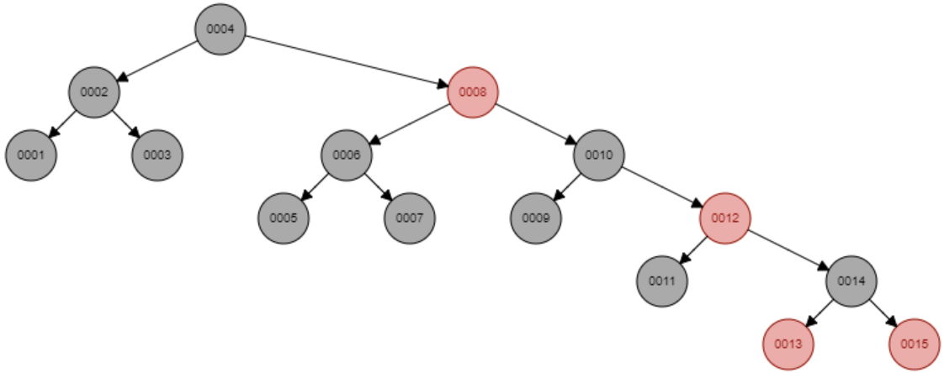
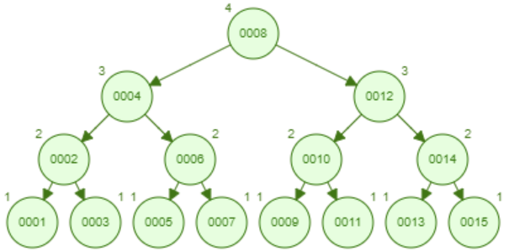
1,2,3,4,5,6,7,8,9,10,11,12,13,14,15
1
2
3
4
BST
5
6
Red-Black
(9 rotations)
7
8
9
10
11
12
13
14
2-3-4 B-Tree
15
AVL
(11 rotations)

Slide 65
Be Safe

